Slide 1

Autonomous Notification
Intelligence
Evolving from mechanical delivery to cognitive evaluation
“Reimagining how platforms make notification decisions in real-time.”

Slide 2
THE CHALLENGE
Problem Statement
Notification Fatigue & Noise
Current systems operate purely mechanically, firing alerts for every upstream event without context or user awareness.
Overwhelming Volume: Users receive redundant alerts across multiple channels.
Lack of Context: Messages lack real-time evaluation of user intent or urgency.
Diminishing Engagement: High opt-out rates and ignored critical security alerts.
70%+
UNACTIONABLE ALERTS
Sent without cognitive filtering
65%
USER DESENSITIZATION
Disable notifications completely
The Core Need
To shift from blind message dispatching to an intelligent cognitive engine that evaluates if, when, and how a notification should be delivered.
“High volume delivery without intelligence turns critical communication into background noise.”

Slide 3

THE FUTURE OF NOTIFICATIONS
What if Notifications Could Think?
Today, platforms answer: “What should I send?”
Tomorrow, they should answer: “Should I send it, when, through which channel, and is there a better way?”
PAST
PRESENT
FUTURE
Notification Delivery
Purely mechanical execution. Focuses on system uptime, message triggers, and basic template rendering.
Notification Intelligence
Rules-based orchestration. Incorporates user channel preferences, basic throttling, and static logic.
Autonomous Notifications
Cognitive reasoning engine. Self-evaluates necessity, optimal timing, channel routing, and event bundling.
→
→
“We are not proposing another notification channel. We are proposing a fundamental evolution of the notification platform itself.”

Slide 4
ECOSYSTEM OVERVIEW
Where We Are Today
A Powerful Ecosystem
Multiple upstream systems constantly generate operational events.
Credit Card & Debit Card
Account Updates
Payments & Transfers
Security & Fraud Alerts
Other Enterprise Systems
UPSTREAM SYSTEMS
Credit Card
Debit Card
Account
Payment
↓
Notification Platform
Central Operational Hub
↓
DELIVERY CHANNELS
Email
Push
SMS
“Our platform already sits at the center of a very large operational notification ecosystem.”

Slide 5
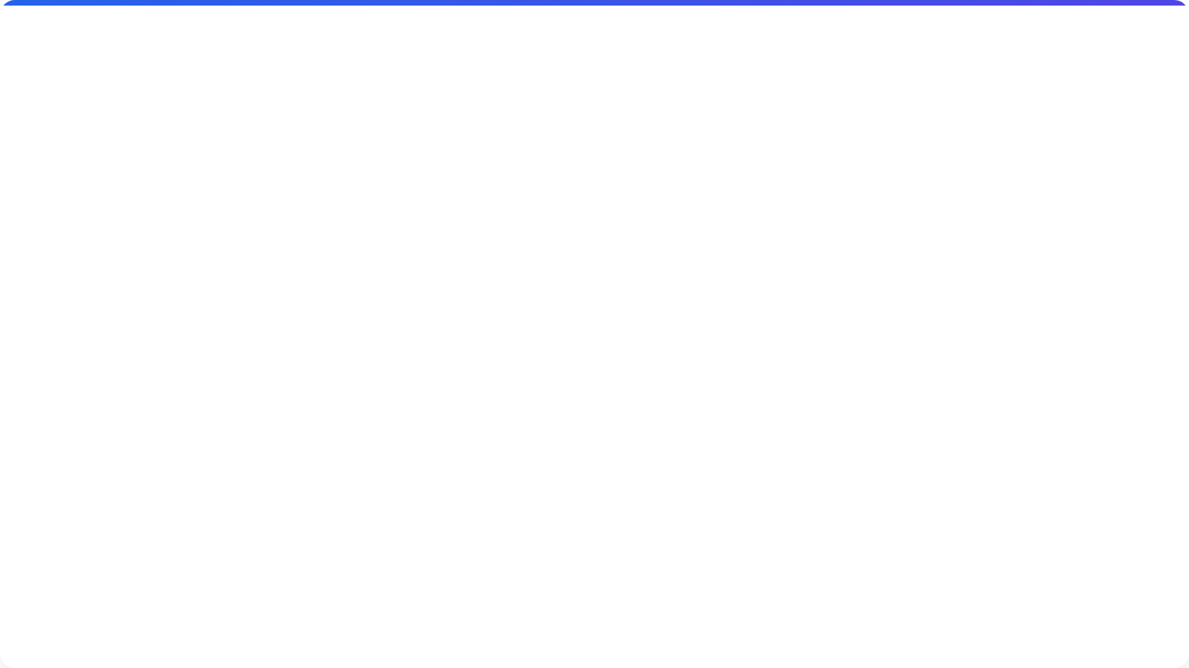


What Happens Today?
Event Happens → Notification Delivered
Optimized For Execution
The current platform is highly optimized for mechanical delivery, but lacks cognitive evaluation.
Reliability Ensuring the system stays up.
↓
Scalability Handling massive volumes.
↓
Delivery & Retry Getting the message out and handling failures.
Monitoring Tracking system health.
↓
“We are excellent at delivering. But delivery is only one part of the notification experience.”

Slide 6
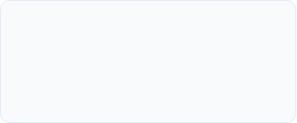

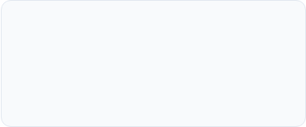
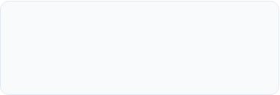

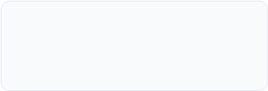
The Opportunity
What happens between "Event" and "Send"?
A notification request arrives. But several critical questions remain unanswered by a purely mechanical system:
01.
02.
03.
Is this notification still necessary?
Did we already notify the customer?
Is another related notification coming?
04.
05.
06.
Is this the right channel?
Is this the right time?
Can multiple events be combined?
“Today these decisions are largely predetermined. Tomorrow they can become intelligent.”

Slide 7

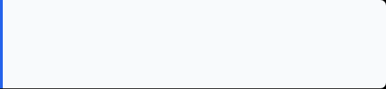
The Customer Problem
More Notifications ≠ Better Communication
Customers often receive multiple operational notifications within a short window:
▪
Payment Due
“The problem isn’t that individual notifications are wrong. The problem is that the platform doesn’t have a holistic view of the notification journey.”
▪
Payment Processed
▪
Balance Updated
▪
Transaction Alert
▪
Statement Available
5 Valid Alerts
→
1 Overwhelmed Customer

Slide 8
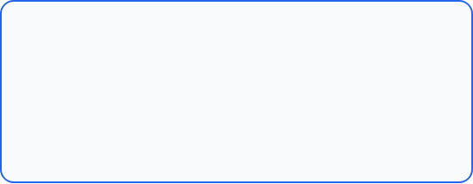
The Hidden Signal We Already Have
Our Notifications Are Already Telling Us a Story
We already possess valuable engagement signals within our ecosystem:
EXISTING CAPABILITY
Notification requests & history
Open-Rate-Tracking Service
Delivery status & Channel info
This forms the foundation of our sensory data.
Email open data & Push engagement
Notification type classification
Key Message: The platform already has the sensors. We just need to add intelligence.
Subscription & preferences

Slide 9
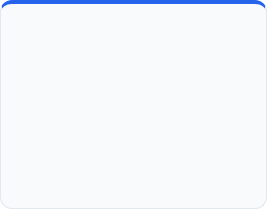
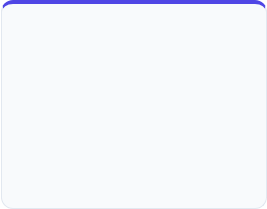
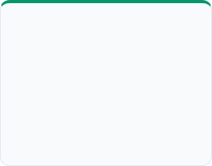
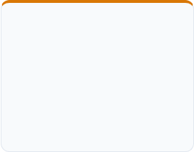
The Vision: Give the Platform a Brain
Introduce AUTONOMOUS NOTIFICATION INTELLIGENCE
An AI-powered layer that understands context and autonomously determines:
DECISION 1
DECISION 2
DECISION 3
DECISION 4
WHAT
WHEN
WHERE
WHETHER
Should this notification happen at all?
Should it be sent now or delayed for later?
Email, Push, or SMS based on context?
Send, suppress, merge, or recommend?
“Our existing platform becomes the reliable delivery backbone, while the intelligence layer makes the communication smarter.”

Slide 10
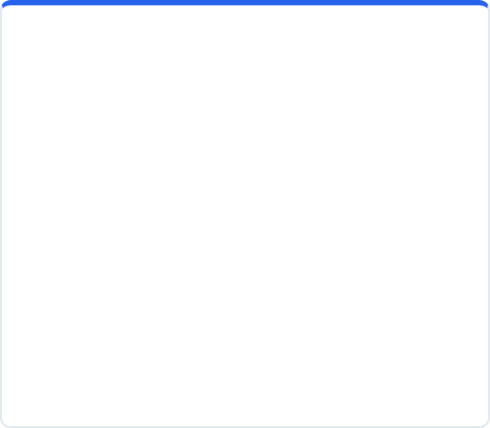



One Platform. Two Intelligence Engines.
ENGINE 01
ENGINE 02
Subscription AI
Notification AI
Intelligent Subscription Recommendation
Autonomous Notification Orchestration
Determines what operational alerts the customer should receive based on their engagement history.
Determines how each individual notification should be handled, timed, and routed.
"What should I receive?"
"How should I receive it?"

Slide 11
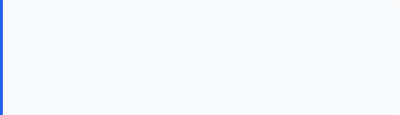
Intelligent Subscription Recommendation
Don’t Make Customers Discover Important Alerts
EXAMPLE RECOMMENDATION
Customers may be eligible for multiple operational notifications (e.g., Payment Due, Confirmation, Transaction Alert).
"We noticed you check your statements frequently. Would you like to receive Payment Due reminders?"
Instead of expecting customers to hunt for every available alert, the platform proactively recommends relevant subscriptions.
“This is not marketing. It is helping customers subscribe to operational information relevant to their existing relationship.”

Slide 12







Learn From the Notification Relationship
How can we recommend without knowing everything about the customer?
We don’t need web browsing or marketing behavior. We can build intelligence purely from the signals we already own.
+
+
Key Message: We learn notification behavior — not personal behavior.
+
↓
Notification Engagement Profile

Slide 13
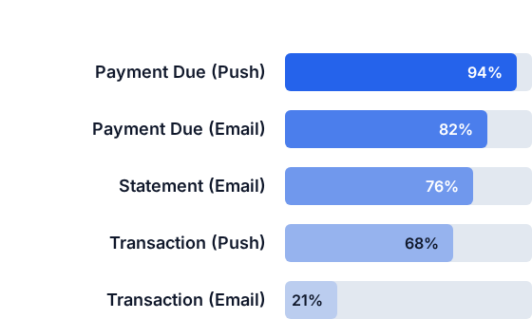

Example: Notification Engagement Profile
Customer ECN: #123458901112 Profile
PLATFORM INSIGHTS
High engagement with Payment Due alerts.
High engagement with Statements.
Strong Push engagement overall.
Lower Email engagement for certain types.
"This understands how the customer interacts with our operational notifications, not their entire life."

Slide 14

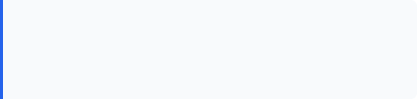

From Engagement to Recommendation
Example Scenario
Customer frequently engages with Payment Due. The platform identifies an eligible related alert: Payment Confirmation.
+
+
RECOMMENDATION
"Would you like to receive Payment Confirmation alerts?"
+
↓
Business Goal: Increase useful operational email subscriptions and engagement.

Slide 15
But Subscription is Only Half the Story
Event Occurs → Subscribed → Should we send?
What Happens After the Customer Subscribes?
The intelligent platform asks:
“
Was a similar alert already sent?
1
Subscription tells us what the customer wants to receive.
Autonomous orchestration decides how to deliver it intelligently.
Is this event related to another event?
2
Is the notification urgent?
3
Which channel is appropriate?
4
— Core Orchestration Principle
Should we send immediately, wait, or combine?
5

Slide 16
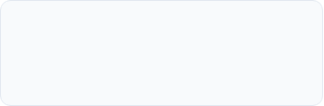
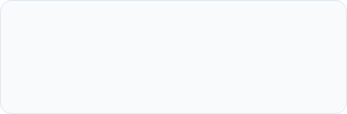
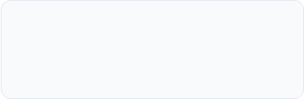
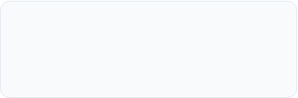
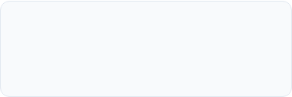
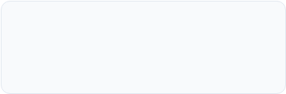
Autonomous Decision Engine
Every Notification Gets an Intelligent Decision
Deliver immediately.
Wait for a better moment.
Avoid redundant communication.
Suggest additional subscription.
Combine related events.
Choose appropriate channel.

Slide 17
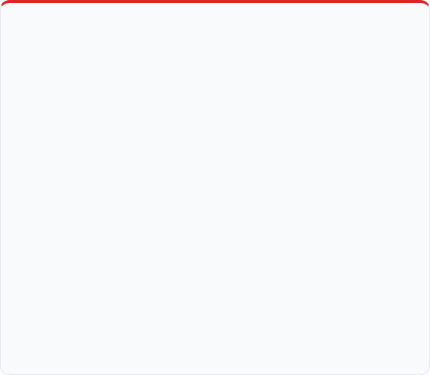
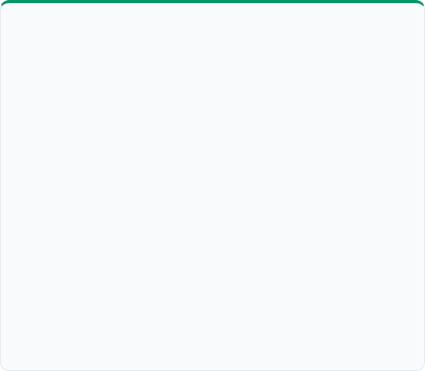
Scenario 1: Autonomous Suppression
Issue: The same event is received multiple times (e.g., PAYMENT_DUE x3)
Traditional Platform
Autonomous Platform
Request 1 →
↓
Request 2 →
↓
Request 3 →
↓
Result: Notification Noise
Outcome: Less Notification Noise

Slide 18
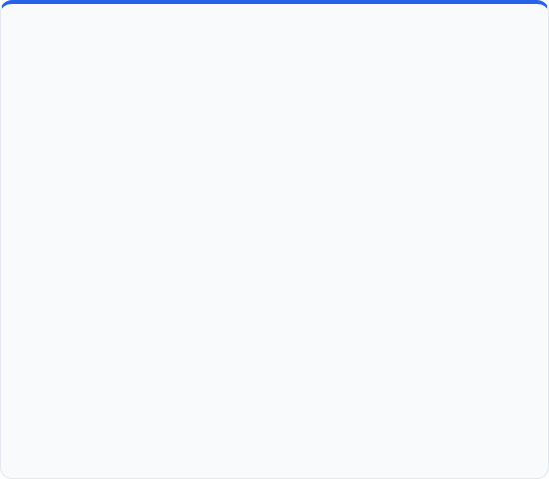






Scenario 2: Intelligent Consolidation
Issue: Notification Storm (Payment Due + Processed + Balance Updated)
Traditional Approach
Autonomous Approach
1. Credit Card
Payment Due
↓
2. Payment Sys
Payment Processed
3. Account Sys
Balance Updated
↓
Result: 3 separate, fragmented notifications
Outcome: Fewer Messages. Better Experience.

Slide 19
Scenario 3: Channel Intelligence
The Best Channel Is Not Always the Requested Channel
Example: Payment Alerts context demonstrates higher user responsiveness via Push notifications over traditional Email.
Email Engagement
72%
Push Engagement (Optimal)
94%
Standard Routing Logic
Standard Event (e.g., Payment)
Policy Override Logic
Critical Event (e.g., Security)
Engagement
Priority
Decision
High Priority
Policy Engine
→
→
→
Selected Output Channel
PUSH
Selected Output Channels
PUSH + EMAIL / SMS
Important: Business rules always govern the AI decision.
While engagement data optimizes routine notifications, explicit policy controls guarantee multi-channel delivery for essential events.

Slide 20
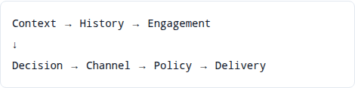
The Role of LangGraph
What LangGraph is NOT
What LangGraph IS
The email delivery engine
✕
PRIMARY ROLE
THE AI WORKFLOW ORCHESTRATOR
Kafka / Event Bus
✕
It coordinates the stateful decision journey:
The ML model itself
✕
The deterministic rules engine
✕

Slide 21

Inside the LangGraph
The Autonomous Notification Decision Graph
Multi-Step Decision Journey
START
↓ Load Context
Rather than making a single LLM call, the workflow orchestrates specialized nodes for specific evaluations.
↓ Check Subscription
↓ Check History & Engagement
↓ Determine Priority
↓ Should Notify?
“This is where LangGraph becomes useful — it orchestrates a multi-step decision journey.”
├── NO → SUPPRESS
└── YES
↓ Choose Channel
↓ Related Event?
├── YES → MERGE
└── NO
↓ Policy Check
↓
↓ Capture Feedback

Slide 22
Target Architecture
Autonomous Notification Intelligence
Upstream Systems: Flow into Kafka.
Stream Processor: Validates events.
Intelligence Layer (LangGraph): Orchestrates Context, Engagement, Decision, Recommendation.
Existing Platform: Executes delivery.
Feedback Loop: Feeds engagement data back.

Slide 23
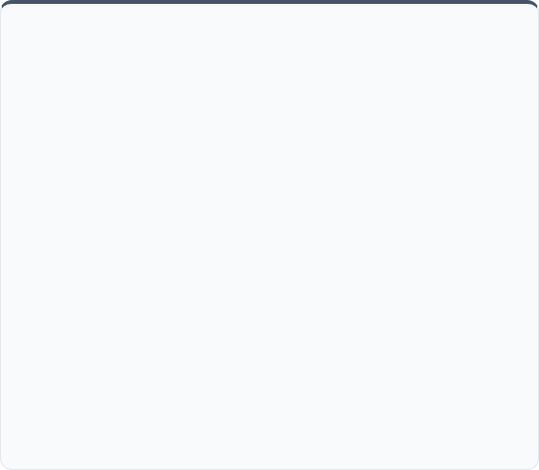
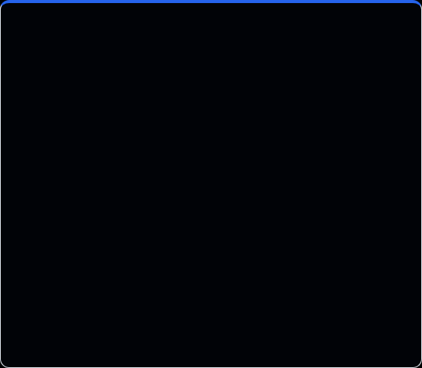


AI Doesn’t Replace What Already Works
Existing Platform Continues to Own:
New Intelligence Layer Owns:
Notification delivery & Providers
Context & Decisioning
Templates
Recommendation & Learning
Retry & Failure handling
Consolidation & Suppression
Channel integration
Channel optimization
Monitoring & Reliability

Slide 24



The Feedback Loop
Every Notification Makes the System Smarter
Example
→
Payment Due
↓
Email Open Rate → 70%
Informs future recommendations
Push Open Rate → 94%
↓
Informs future channel optimization
“The platform doesn’t just send notifications. It learns from them.”
↓

Slide 25
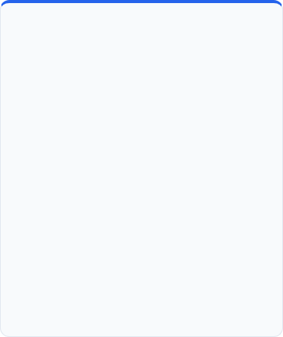
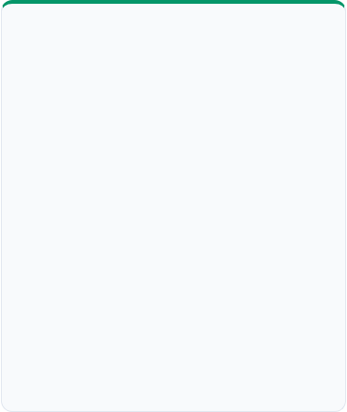

What Do We Gain?
CUSTOMER
BUSINESS
PLATFORM
More relevant operational alerts
Increased subscriptions
Intelligent decision layer
Higher email engagement
Continuous optimization
Less notification noise
Better notification effectiveness
Reusable AI capabilities
Better channel experience
Extensible architecture
Timely information
Reduced redundant notifications
Better channel utilization
Easier discovery of subscriptions
Lower notification fatigue

Slide 26
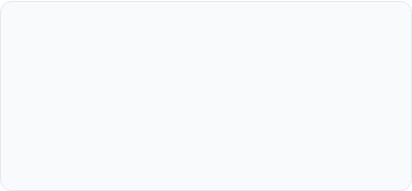
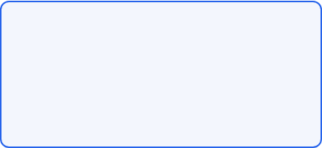

The Future Isn’t More Notifications.
It’s Smarter Notifications.
TODAY
TOMORROW
"Business systems tell us what to send."
"The platform understands the context and determines the best way to communicate it."
EVENT → UNDERSTAND → DECIDE → ACT → LEARN → ADAPT
WE ARE GIVING IT A BRAIN.

